Slide 1






Computing Research Projects Repository (CRPR)
Try SlidesI

Slide 2

Problem statement
The Department of Computing lacks a centralized platform to effectively catalog and showcase ongoing research projects across various computing domains. This deficiency hampers transparency, knowledge sharing, and interdisciplinary collaboration among researchers, students, and stakeholders..

Slide 3

Agenda
Project Overview
Our Process
Key Services
New and Upcoming Projects
Recently Completed Projects

Slide 4
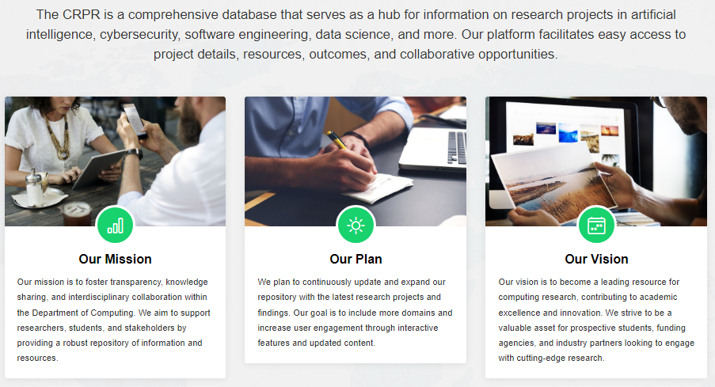
Project Overview

Slide 5

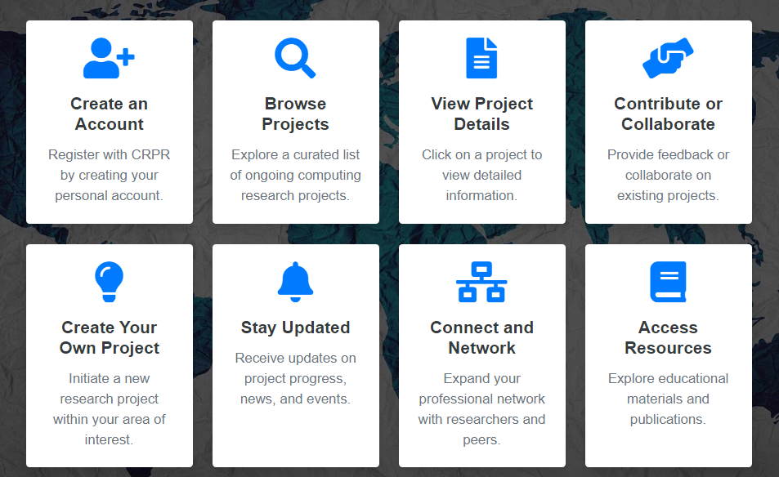
OUR PROCESS
HOW IT WORKS

Slide 6





Key Services
Comprehensive Database
Easy Accessibility
Collaboration Opportunities
Regular Updates

Slide 7



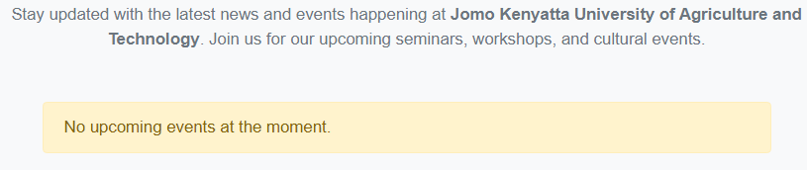
New and Upcoming Projects
Future of quantum computing
Computing
research
CRPR

Slide 8


Recently Completed Projects
EXPLORE THE WORLD OF BINARY
Exploring the world of binary opens up a fascinating realm of digital representation and computation
C#
C# (pronounced "C-sharp") is a modern, object-oriented programming language developed by Microsoft. It’s designed for a wide range of applications, from desktop software to web applications and game development.
.

Slide 9

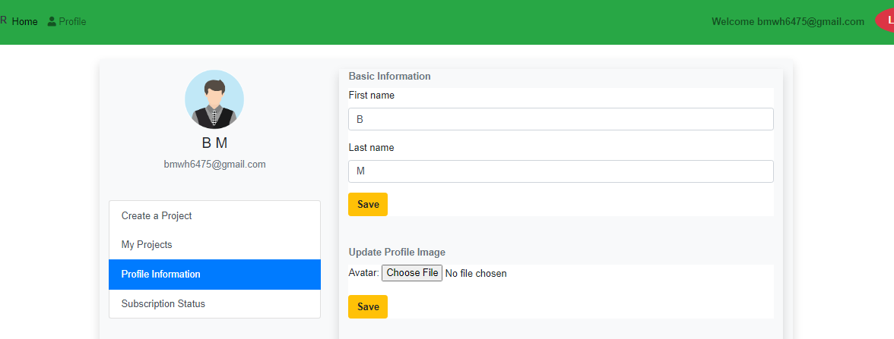
Expected Results
Login System
Ensure that only authorized users can access certain parts of the system.
Profiles sections for users account
User interaction and personalization.

Slide 10

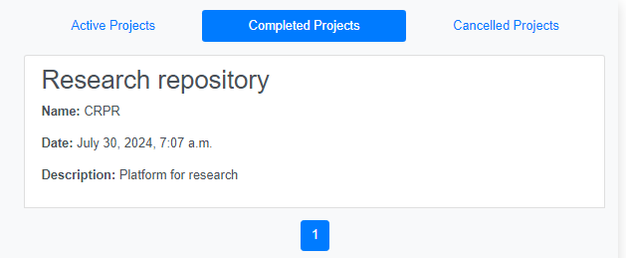
PAYMENT METHOD INTEGRATION
payment to access important research work
Projects section
View projects in their current status either complete active or completed

Slide 11

Collaborators section

Slide 12


What Our Clients Say
Working with them was a seamless experience. They delivered beyond our expectations."
Joe Nderitu
Great team enhancing computing research."
Boniface M warigi

Slide 13
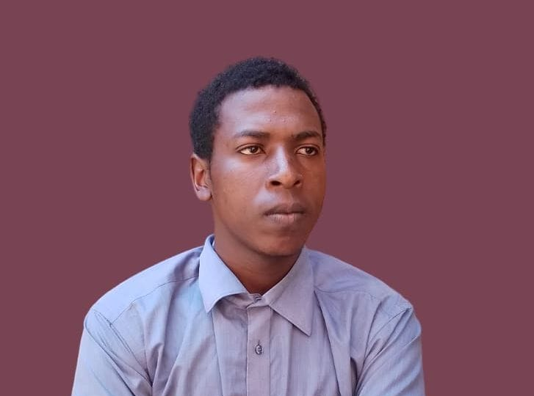
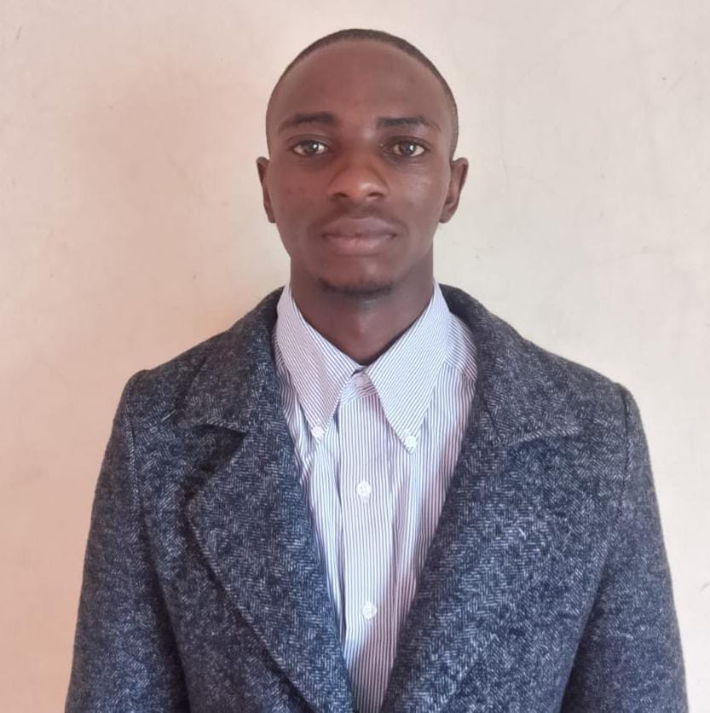
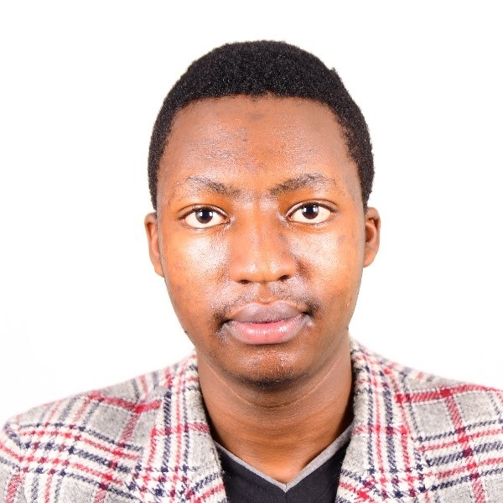
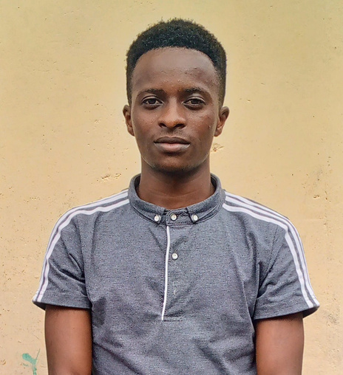
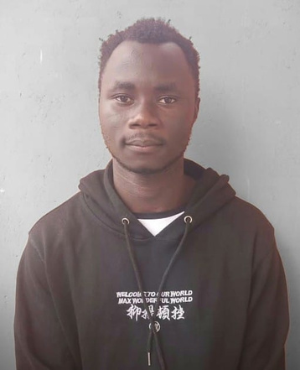
The Minds Behind Our Vision
Joseph Nderitu
Boniface Mwangi
Felix Ouma
FULL STACK DEVELOPER
Web &Software Developer
Frontend Developer
Alex Maina
Loren Odhiambo
Frontend Developer
Web Developer

Slide 14


Get in Touch
Phone: +254705516200
Email: researchhubx7@gmail.com
Website: www.researhhubx.jhubafrica.com
Jomo Kenyatta University of Agriculture and Technology,
Address: P.O. Box 62000 – 00200 NAIROBI, KENYA,
LinkedIn: Researchhubx7
Facebook: Researchhubx7
Instagram: Researchhubx7

